Slide 1
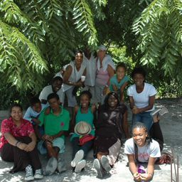
Jamaica Ambassador Programs

Slide 2
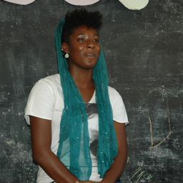
INTRODUCTION

Slide 3
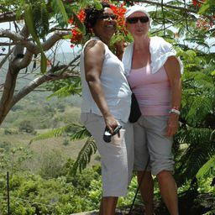
EVETH COLLEY-WOMAN ON A MISSION
There are a lot of non profit organizations that need help but there are organizations that tug on your heart. I heard about this particular organization from my mother who met up with a co worker from twenty years ago. Her name is Eveth Colley and she founded the Jamaica Ambassador Programs (J.A.P) and when asked why, she states:
“The primary purpose of my visit to Jamaica in September 2010 was to spend some time with my parents in Montego Bay, Jamaica and a few days of personal relaxation at a hotel. Although this visit to Jamaica represents one of the best vacations I ever had, my heart was very heavy and my spirit greatly disturbed by the poverty and lack of progress I saw in the Flower Hill area where I lived prior to migrating to the U.S. approximately 30 years ago. When I asked questions as to why things were still the same and maybe worse, the responses I received were directed to corrupt governments etc. While they may be correct in identifying this as the source of these issues, I still could not accept this as the final answer, because it would mean that the children of this generation would be continuing a cycle of poverty and hopelessness. When I returned back to the U.S, although I felt so happy about my vacation, I also felt equally sad about the impact of the conditions I saw. It was then that I believe God impressed upon me that it was now up to me to make a difference to what I saw and felt. Feeling inspired and excited about the opportunity to channel these strong emotions, this idea was conceived and this plan drafted as my way to contribute towards a positive change.”

Slide 4
Jamaica Ambassador Programs
Jamaica Ambassador Program’s Slogan is “Promoting Education as a Path to Progress”.
Mission: To encourage achievements that lead to economic progress and empowerment through education.
Vision: To be a contributor to organizations and activities that enables a vibrant and self sufficient community.
Goal: To win the fight against the cycles of poverty and oppression by helping children and communities to attain a progressive lifestyle through academic achievements.
Objective: Accomplish this goal through mentoring and forming alliances with those who are willing and able to donate time, money, resources and services to the targeted community. Encourage the achievement of excellence for life through education and empowerment

Slide 5
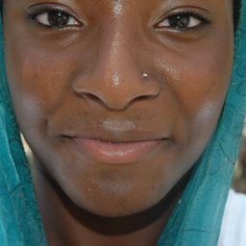
Alexis Roberts— C.H.O.I.C.E.S
After reviewing J.A.P.’s mission, I wondered how children would find the motivation to attend school with so many variables such as transportation, lack of food, no running water, and challenging home environments. My program was designed to complement Ms. Colley’s mission. It is based on the need for children to realize the opportunities before them and to be aware and knowledgeable in the fact that they have choices for career opportunities. I also believed that the Children of Flower Hill needed a partners and motivators—people of their generation to connect with. My vision is to engage my school ,community, and foundation to help support the idea that there is a chance for every individual on this earth to thrive in ways unimaginable–they just need to be aware of their opportunities. My vision is quite simple:
C.H.O.I.C.E.S Children Helping Others Increase Career Educational Services
Explore alternative careers in Jamaica and identify the tools needed to secure specific employment.
To increase the amount of students who have maintained their careers path.
Provide exposure and opportunity that will holistically develop children into contributing members of society

Slide 6
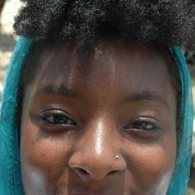
More-C.H.O.I.C.E.S
I have broken my mission into three phases:
Phase I
Survey students to see what they currently know about the opportunities available to them. This is important to identify gaps in information and what the focus should be in terms of career highlights and measure how they feel about being able to achieve those goals.
Conduct career introductory workshops
Phase II
Design and develop group opportunity to be on JAP’s website.
Implement period survey to know the impact of C.H.O.I.C.E.S. and determine how to improve its effectiveness.
Phase III
Pair student with a U.S. Student with similar interest and career objectives, Career buddy. It is sometimes helpful when students of the same age have similar goals and objectives and pair up for encouragement, information, and resource sharing, similar to each one teach one. (a) They can share environmental and emotional challenges to meeting their objective and work together to come up with solutions. (b) They can also help each other with adult input on how to best achieve their career objective. (c )All communication should be supervised so that the children stay on track.
Here is Phase I in conjunction with the services provide by J.A.P.:

Slide 7
PREPARATION
We arrived in Jamaica on Sunday July 20th,2014 and checked into the Hotel RIU. Jamaica appeared beautiful, pristine, and a lovely vision of Paradise from the views at the hotel.
We spent the first day preparing for the school supply distribution at the home of a local native by the name of Esther. This was our first indication that Paradise was a state of mind and not a place. The homes we passed had gates and lots of dogs. We found out that this was because of the high crime rate in Jamaica. Despite this knowledge, we prepared 365 book bags with notebooks, pens, pencils, geometry sets, toothbrushes donated by Principal Life Insurance, crayons, markers, and other items. We loaded, we unloaded, we sorted, we packed and we transported to the schools we would work with. Whew! Lots of sweat equity!

Slide 8
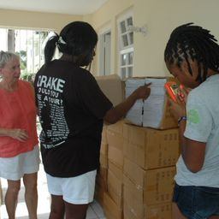
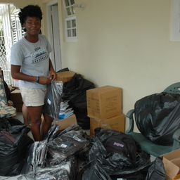
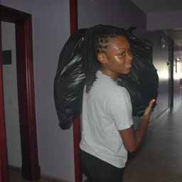
Preparing for the Journey to Success

Slide 9
Travel to Flower Hill
We arranged for a bus to transport us daily back and forth from the hotel to Flower Hill, it picked us up in the morning 8:30 a.m. and from Flower Hill at 3:30 p.m.
From the Iron shore vicinity, Flower Hill can be easily identified from the many cell phone towers owned by Digicel, one of the key cell phone providers in Jamaica. It is beyond our comprehension that these towers are allowed to be so frightfully close to the residents. They are looming dangerously over the community, directly across from the Flower Hill Central Basic School which houses their name to show their financial contributions for building it.
When you google Flower Hill on the internet, luxury villas are shown but the Flower Hill we travelled to had colorful shacks, unfinished homes, no running water and roads badly in need of repair.
Flower Hill is a natural paradise overwhelmed by the poverty of resources where people can thrive, they only barely survive.

Slide 10
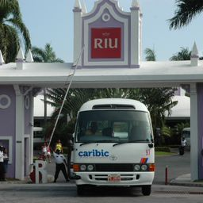
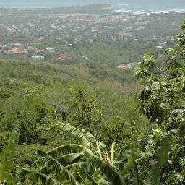
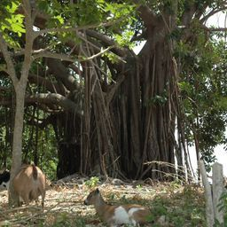
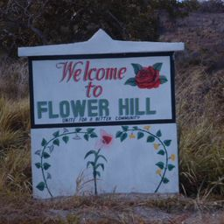
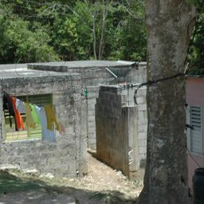
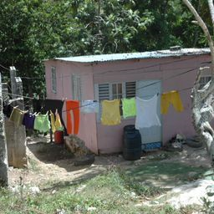
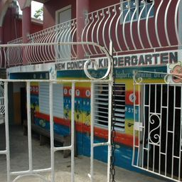

Slide 11
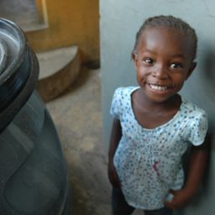
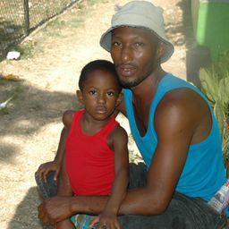
Greetings
I have never in my life met friendly oppression. The community was warm, inviting, and embraced our mission. The faces could rip your heart in two. Behind the smiles we could detect the desperation and fear of their plight.

Slide 12
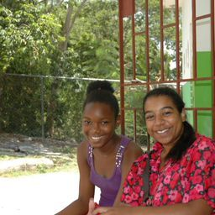
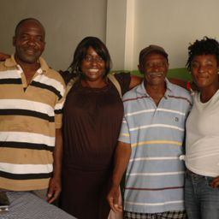
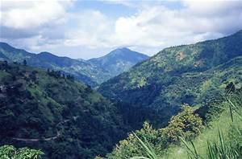
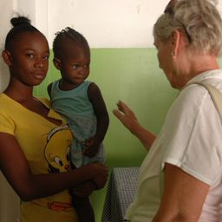
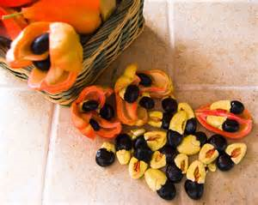
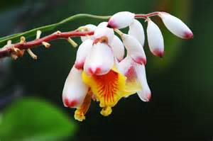
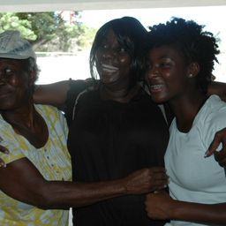
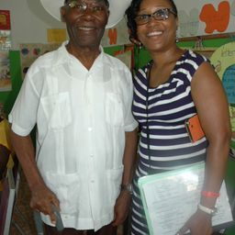
Greetings

Slide 13
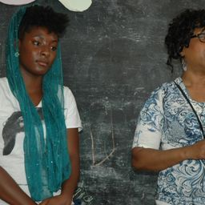
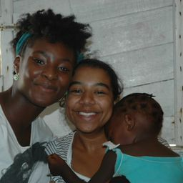
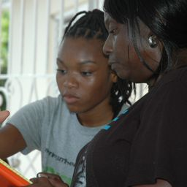
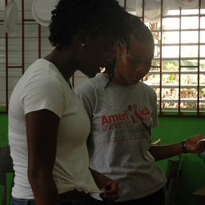
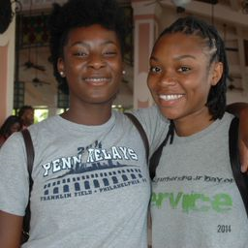

Slide 14
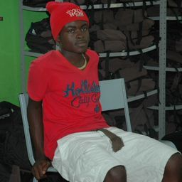
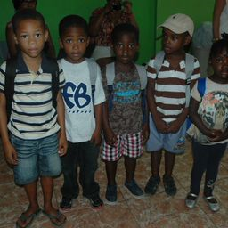
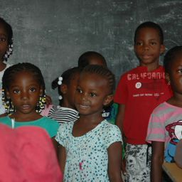
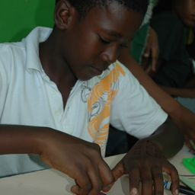
The Faces of Our Benefactors

Slide 15
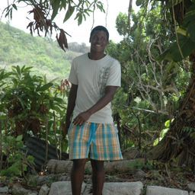
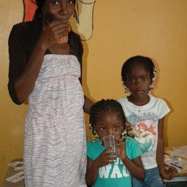
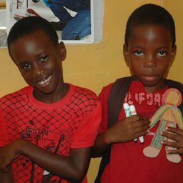
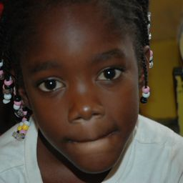
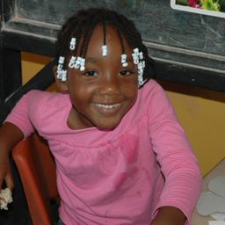
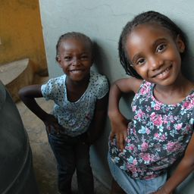
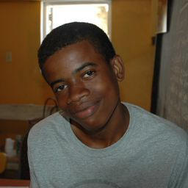
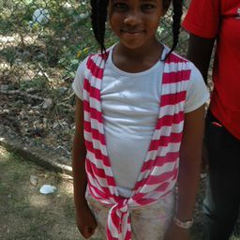
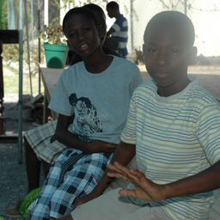
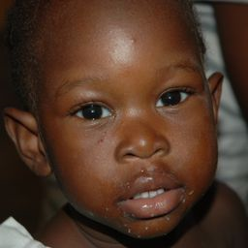
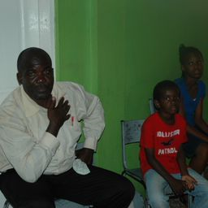
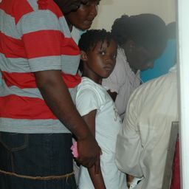
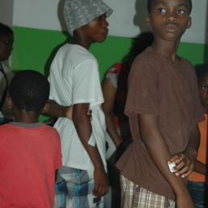
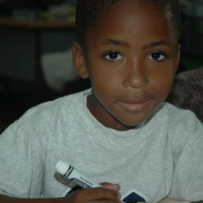
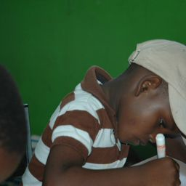

Slide 16
Community Sale
Through the efforts and donations of the Jamaica Ambassador Programs, the community held a flea market sale. Hundreds of items were sold at extremely affordable prices to the Flower Hill community. All proceeds went back to the two schools, Flower Hill Central Basic and New Concept Kindergarten. This was also an opportunity to speak individually to the children to survey their aspirations and what they knew about the Jamaica Ambassador Programs.

Slide 17
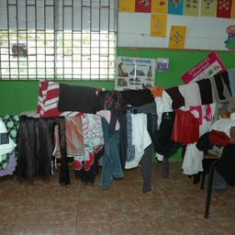
Community Sale
Dress for Success

Slide 18
Distribution
The Jamaica Ambassador Programs (J.A.P) distributed the school supplies and had one on one conversations with parents and students alike regarding report cards and needs.
Flower Hill Citizen’s Association was our on the ground sponsor and they facilitated the arrangements for us to implement our activities. This also included delicious refreshments for us and for the recipients which we greatly appreciated since Flower Hill has no restaurants or grocery stores.
Based on a conversation with the principal of one of the basic schools who informed us that some of the students at the kindergarten school could not afford lunch, we were able to also collect food in the U.S which we shipped, this was donated lunch to the two schools, this was the first of our four missions where food was donated.

Slide 19
Distribution of School Supplies

Slide 20
Tools of Success

Slide 21
Where the Journey to Success Begins

Slide 22
Reaching Out to the future One Child at a Time

Slide 23
Reading is
Fundamental

Slide 24
C.H.O.I.C.E.S
While the distribution was in progress, the children were divided into three groups. Group 1 –Children, ages 2-6 . They were shown flash cards of different jobs in the community and were allowed to match the roles with the tools they needed. They were given paper dolls which they colored with great enthusiasm, to show what career roles they wanted to be.
Group 2 –Children age group 7-13. They played Headbanz , this game required that a card be placed on the top of your head, other children gave clues and the person wearing the headband had to guess what was the career, it was amazing to see how much fun learning could be. The cards were a reflection of who you could be, where you could be, and people who achieved these goals. The message of hope and opportunity was delivered in an exciting way and everyone walked away with good information. The children also created a poster of what they wanted their communities to look like.
Group 3 –Children age group 14-18. This group were mentored and shown entrepreneurial skills. They were challenged to create their own opportunities. One young lady started her own business in the days that followed and had her first customer when we left. They also engaged in a game of Cash flow for kids by Rich Dad Poor Dad to introduce financial wellness.

Slide 25
C . H . O . I . C . E . S

Slide 26
Gratitude
Our daily objective was to give hope and encouragement from our hearts yet, they gave us the warmth of their spirit in so many ways. To show their gratitude for all we had done, the community gave back to through the children singing to us, through the wonderful lunch they fed us and through the farewell Thanksgiving Ceremony that brought tears to our eyes. With simple resources, they build an outdoor tent which fought the wind to shield us from the summer sun, they built a platform for us to sit high so they could honor us. Many invited community dignitaries attended who spoke words of encouragement to the community and thanked us for what we gave to them. We were allowed to speak, and presented us with awards! As if we had not already fallen in love with this community.

Slide 27
SINCERE GRATITUDE AND APPRECIATION

Slide 28
THANKSGIVING CEREMONY

Slide 29
MORE WORK TO BE DONE
A CONTINUED MISSION

Slide 30
More to come………..
Our mission is not over! I plan on working with J.A.P. over the next few months to
Advocate for water. (This community has not had running water in their pipes for three years!)
Begin Phase II for C.H.O.I.C.E.S Design and develop group opportunity to be on JAP’s website and to determine our impact.
Establish Jr. JAPS Collection Sites on school campus through collaboration with the Wight Foundation.
Create career buddies to encourage the Flower Hill students to stay focused on education to realize their career goals.
Participate in the July 20 – July 25th Jamaica Ambassador Programs 5th Annual Mission to Flower Hill.

Slide 31
BELIEVE IN YOURSELF

Slide 32
Ms. Eveth Colley-founder of J.A.P. and one who does not just talk about things but takes action and without whom I would not have had this experience.
The Colley family – being planted in Flower Hill when Eveth was a child
and taught the values of fighting for humanity.
Grita - the most energetic and fun loving adult I have ever encountered
The community of Flower Hill for allowing us to help
Ms. Stephanie and Ms. Natalie –all smiles all the time
My Aunt Beverly who spearheaded the entrepreneur program
The Wight Foundation for helping me make a world of difference
George School for reminding me to “Shine my light”
Salome Daniels- my most enthusiastic fellow Wight Foundation Scholar/Georgian
Aaliyah Collings- my bestie, photographer, and fellow George School student.
And…My mom for all of her hard work, patience, and love.

